Slide 1


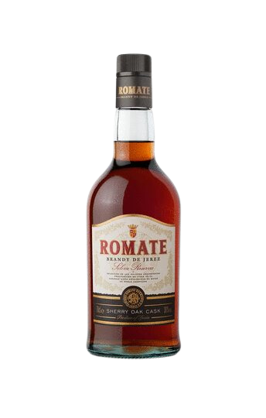
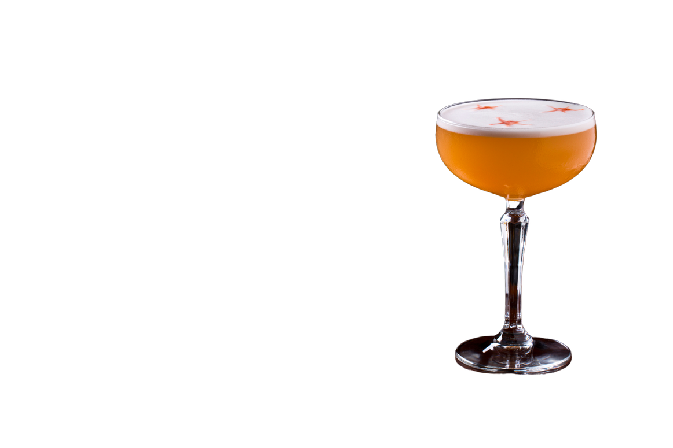
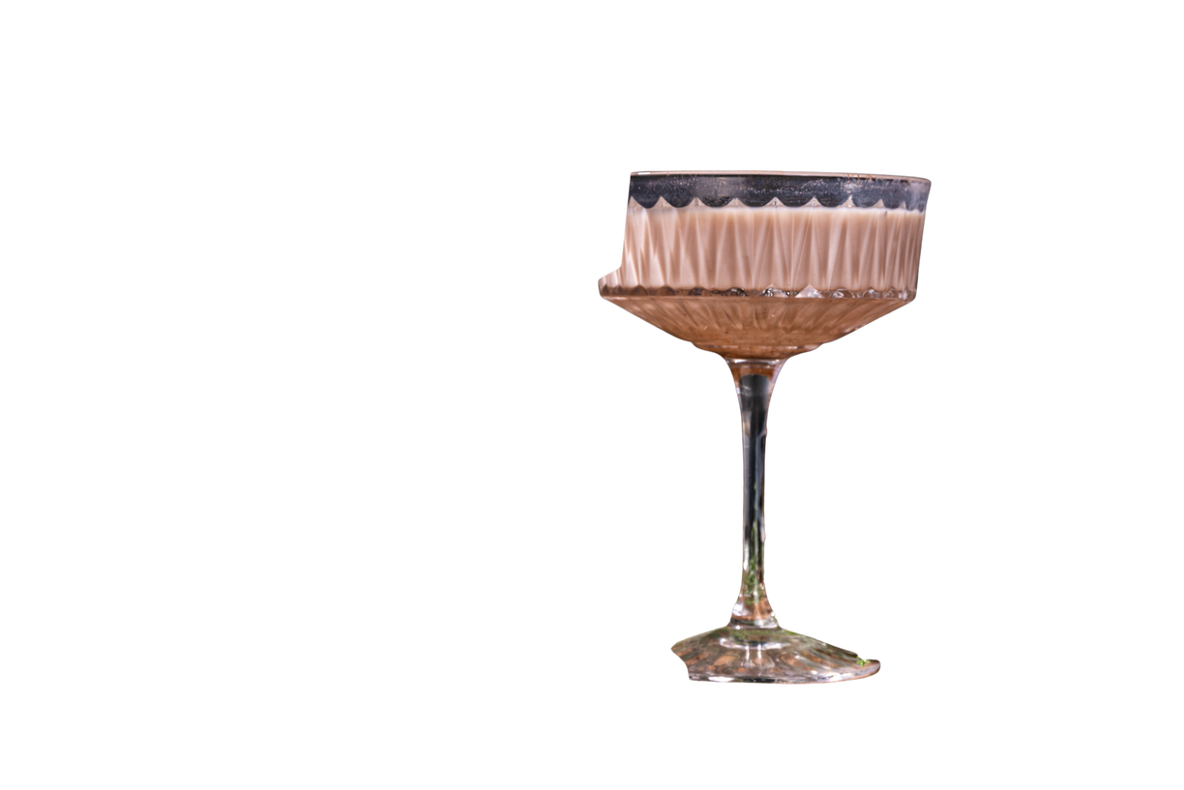
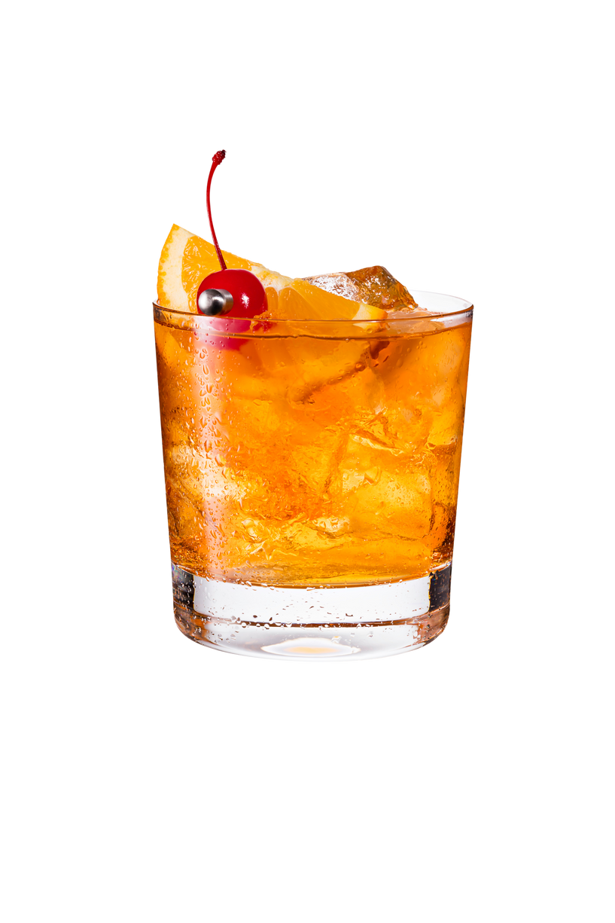



EXCEPTIONAL QUALITY,
UNMATCHED VERSATILITY
A versatile Brandy for every need.
Target Audience: Bars, restaurants, and retailers looking for a high-quality, versatile brandy at a competitive price.
Versatility: Perfect as a bar well option, a premium base for cocktails, and a culinary ingredient for cooking.
Category Growth: Tap into the increasing demand for craft cocktails and elevated dining experiences.
CULINARY VERSATILITY
BAR WELL STRATEGY
  Adds depth to sauces, flambes and desserts.
  A go-to ingredient for chefs aiming to elevate their dishes with a touch of sophistication.
  Premium Well Option: Elevate your bar program with a brandy that's a step above the average well spirits, delivering rich, smooth flavors at an accessible price.
  Cocktail Base: Ideal for classics like Sidecars, Brandy Alexanders, and brandy-based twists on Old Fashioneds.
A solera reserva with a solera price
COST PER OZ ADVANTAGE
  Offers exceptional value for bars and restaurants aiming to maintain quality while managing costs.
  Competitive pricing provides higher profit margins for cocktail menus and culinary uses.
YOUR PREMIUM YET AFFORDABLE CHOICE
BOTTLE SIZE
OZ. PER BOTTLE
COST PER OZ.
SRP
PROFIT MARGIN
750 ml
25.36
1 LTR
33.81
sanchezromate
www.romate.com
@sanchezromate

Slide 2
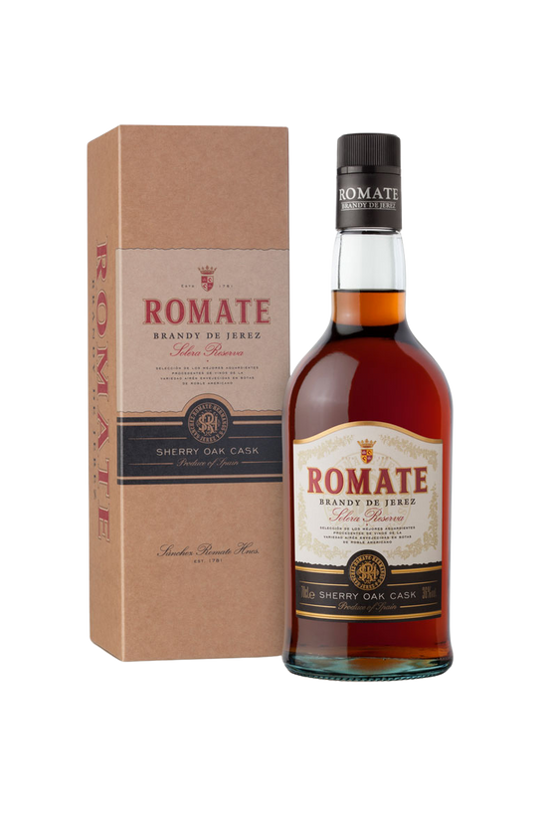

Romate Brandy De Jerez Solera Reserva Spanish Brandy was created in the tradition of Cardenal Mendoza carries the prestigious appellation Brandy de Jerez.
Romate Solera Reserva is a solera brandy, made from distilled wine which is then aged through the solera cask system and then aged for an average of 3 to 6 years in old Oloroso and PX Sherry casks which means that it can be labelled as a Reserva. A new impulse for the classicism of the finest Solera Reserva brandy. Romate Brandy has a perfect taste profile for cocktails as well as an after dinner drink.
TASTING NOTES
Dark and brilliant Clean, round, reminders of wine. Very smooth and warm, slightly sweet, persistent, old oak. It is smooth with a pleasant, oaky bouquet reminiscent of sherry. It is ideal served in the traditional brandy snifter as well as in cocktails.
PRODUCT SPECS
PACK/SIZE: 1/750ML
36% ABV
UPC: 84101615112532
PACK/SIZE: 1/1 LTR
36% ABV
UPC: 8410161512021
BODEGAS SÁNCHEZ ROMATE
The light and air in Andalusia, the climate, and tranquillity of the land, warmth of its people, are the unique ingredients that make Jerez de La Frontera special and give shape to Romate products.
Bodegas Sanchez Romate has been producing some of the best wines and brandies in the world in Jerez de la Frontera since the 18th century.
www.romate.com

